Slide 1
Digital Twin-Enabled
Autonomous Agricultural Rover
For Precision Agriculture and Spatial Telemetry
Team members:
Chittesh D 25BRS1255
Anamithra Govindarajan 25BRS1291
Ramyashri S 25BRS1144
Towards submission of
Innovative Design Project (BACSE291)
Under
Prof. Vergin Raja Sarobin M (50138)
Repository Link :

Slide 2









Problem Statement & Operational Inefficiencies
Undetected Pest Vectors
Blind Chemical Application
Disconnected Telemetry
Manual scouting detects infestations post-damage threshold, resulting in 20–40% preventable crop loss.
Flat-rate pesticide application causes localized over-fertilization, severe soil degradation, and unnecessary chemical runoff.
Conventional field sensors act as isolated data loggers without spatial mobility, real-time actuation control loops, or dynamic 3D mapping visualization.
Conventional aerial drones lack sub-canopy visibility for early-stage ground-level detection.
Lack of spatial mapping leads to high operational expenditure on wasted resources.

Slide 3
Literature Survey
UAV Based Crop Monitoring
Existing research heavily emphasizes aerial drones for agricultural scouting but these systems lack sub canopy visibility and fail to detect early stage ground level pests
Conventional Application Models
Standard agronomic literature and industry practices rely on uniform flat rate chemical distribution and this fundamentally ignores the spatial variability of field conditions.
Static IoT Telemetry
Current environmental monitoring frameworks deploy stationary sensor networks that function strictly as isolated data loggers and they lack spatial mobility along with dynamic 3D mapping and real time control loops.

Slide 4
Challenges & Research Gap
Delayed Pest Identification
Current scouting methods only identify infestations post damage threshold and this causes 20 to 40 percent preventable crop loss. The critical research gap is the lack of an autonomous edge AI driven system for early stage detection under the canopy.
Severe Soil Degradation & Waste
Blind resource application causes unnecessary chemical runoff and massive operational waste. The gap is the inability to track climate acutely and generate localized spatial heatmaps to guide precise interventions.
Absence of a Physical to Digital Loop
Existing technologies fail to bridge physical field data with actionable digital analytics. The unaddressed gap is a real time digital twin architecture capable of mirroring physical kinematics and mapping environmental telemetry within a 3D visual workspace.

Slide 5
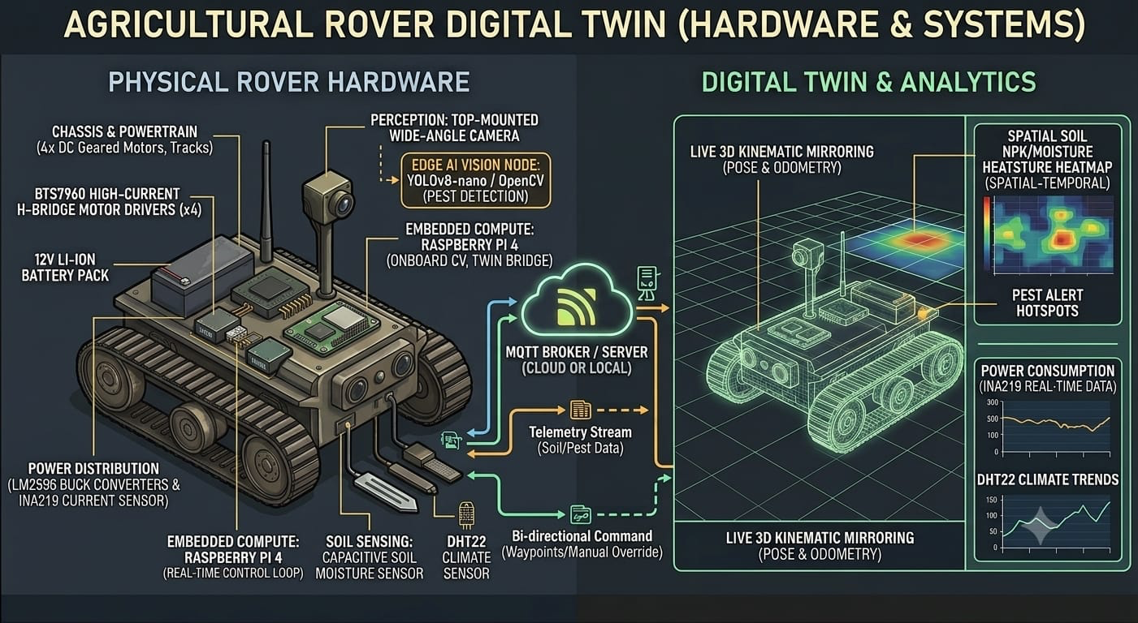
Proposed Solution & Physical to Digital loop

Slide 6
Technical Specifications
Subsystem | Hardware / Framework | Functional Role
Compute & Vision | ESP32-S3 (Dual Core) | Motor PWM, RTOS polling, Edge CV inference, MQTT gateway
Motor Drivers | L298N | Skid-steer high-torque drive control
Perception Sensors | HC-SR04, IMU | Multi-zone collision avoidance & pose estimation
Agronomic Sensing | Soil pH, DHT22 | To track climate acutely and generate heat map
Digital Twin Stack | Three.js, R3F, Next.js | 3D visual workspace, dynamic heatmaps, remote UI control

Slide 7
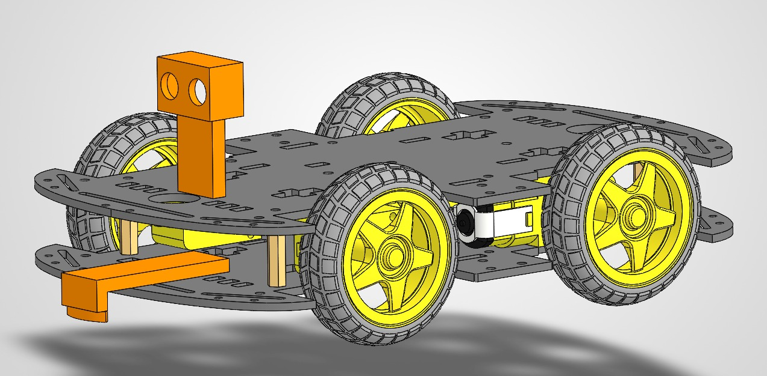
Structural Design

Slide 8
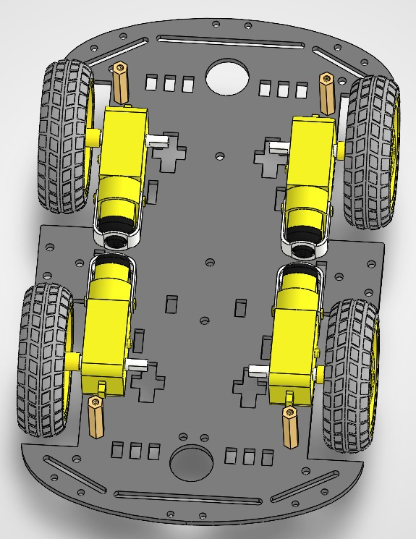
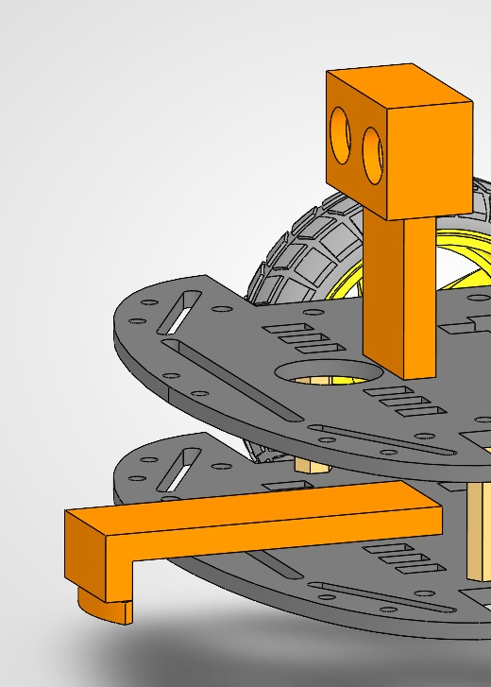
Structural Design

Slide 9
Closed Loop Simulation

Slide 10
Control Flow
The Rover Hardware and Compute Unit
The physical rover acts as the primary data collection and execution layer where the dual core ESP32 S3 processes everything on the edge. One core manages the real time control by polling the DHT22 climate sensor and the soil pH sensor while also sending PWM signals to the L298N motor drivers for physical movement. The second core takes care of the computer vision pipelines and prepares the structured telemetry payloads.
The Telemetry and Network Layer
This unit acts as the bridge between the physical rover and the digital interface. The compute unit packages the physical sensor data into JSON payloads and publishes them upstream to an MQTT broker over WiFi. At the same time the network actively listens for downstream manual drive commands sent via WebSockets and this allows low latency remote control of the rover.
The Digital Twin and Frontend Interface
The web application receives the live telemetry from the MQTT broker and routes it through a state manager. The incoming IMU data continuously updates the 3D kinematic model so the virtual rover matches the exact pose and orientation of the physical rover. The interface also processes the incoming climate and soil pH data to render dynamic spatial heatmaps on the screen so the user can analyze the field conditions.

